Slide 1


Development of Scalable Web Application for Business Management (Integrated with Telegram)
Author: Feruz Farxodov
Date: 2025.06.04

Slide 2


CONTENTS
1. Introduction
2. Project Background
3. Preliminary Research
4. Technical and Engineering Solutions
5. Implementation and Testing
6. Challenges and Limitations
7. Prospects and Plans
8. Thank You

Slide 3

01
Introduction

Slide 4
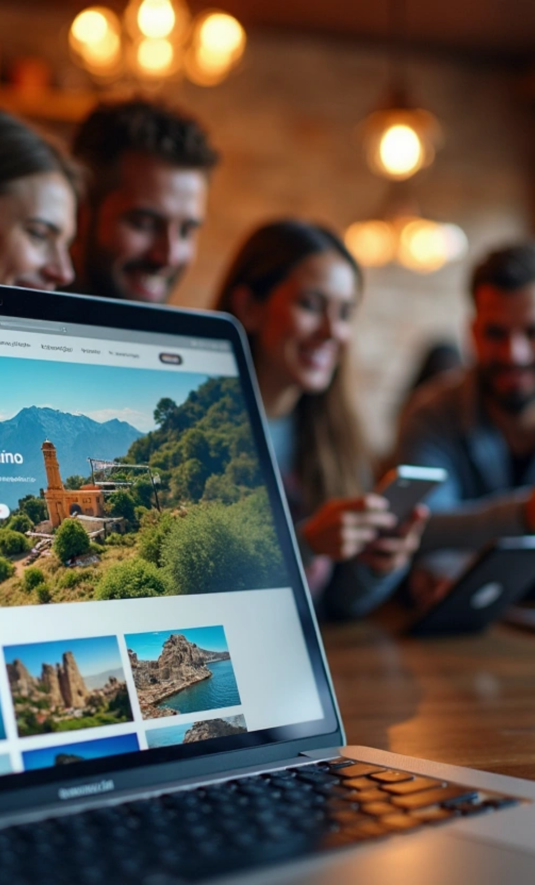

Project Overview
1
Project Name: Scalable Web App for Business
2
Target Business: Travel Agency Site
This app helps Uzbek travel agencies manage operations and offers a user-friendly site for booking tours and sharing feedback, mainly for international tourists.

Slide 5

02
Project Background

Slide 6

Motivation
1
2
3
4
Project Motivation
Booking Tours
Tourism Growth
Project Aim
I chose this project due to poorly structured travel websites in Uzbekistan.
Booking tours is difficult without a deposit or prior knowledge of guides.
More tourists in Bukhara and Samarkand show the need for a better platform.
This project intends to address that issue.

Slide 7

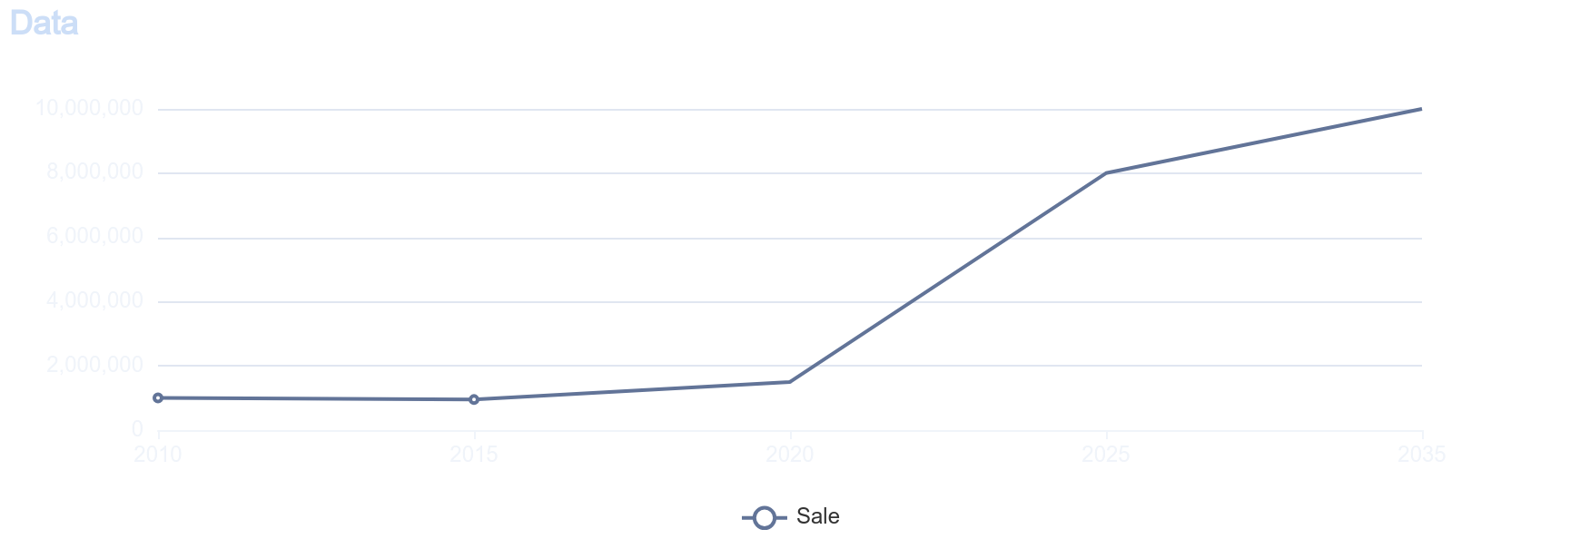
This chart shows how tourist numbers have skyrocketed in recent years, pointing out the reasons behind this surge.

Slide 8

03
Preliminary Research

Slide 9


Results
Before I began, I looked at other travel sites and noticed they usually miss:
1
User-friendly design
2
Ways to give feedback and report issues
3
Easy booking without prepayment
4
Details about company guides
I watched travel vlogs on YouTube and read articles where travelers shared their experiences in Uzbekistan. I even reached out to some visitors to learn about their challenges. This guided the design of my website.

Slide 10

This diagram shows user appreciation for the new website's features.

Slide 11

04
Technical and Engineering Solutions

Slide 12


Tech & Engineering Solutions
Tech Stack
Key Features
• Frontend: HTML, CSS, SASS, React
• Backend: Java with Spring (Boot, Security, JWT)
• Database: PostgreSQL (indexed and optimized)
• Login system
• Admin panel
• Admin 2FA via Telegram
• Telegram bot for user interaction
• Secure JWT auth
• Feedback and user tracking

Slide 13
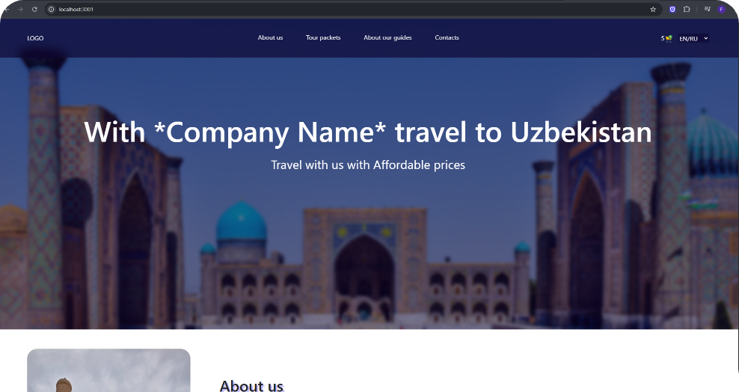
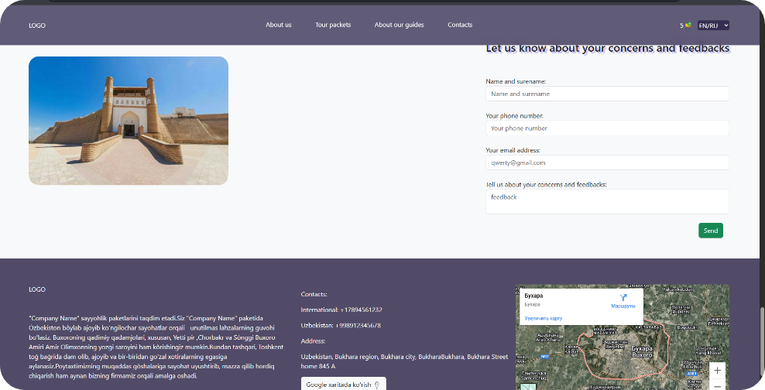
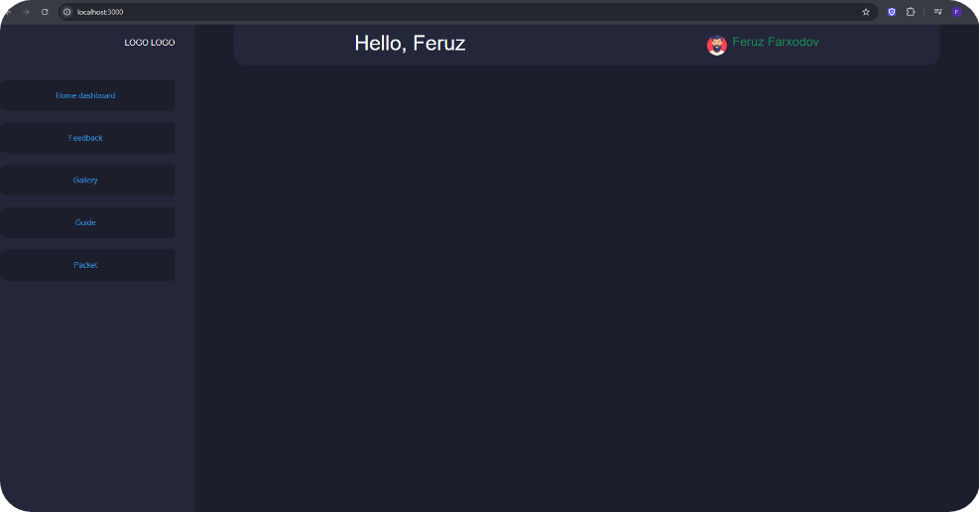
A glimpse of the website's homepage design

Slide 14

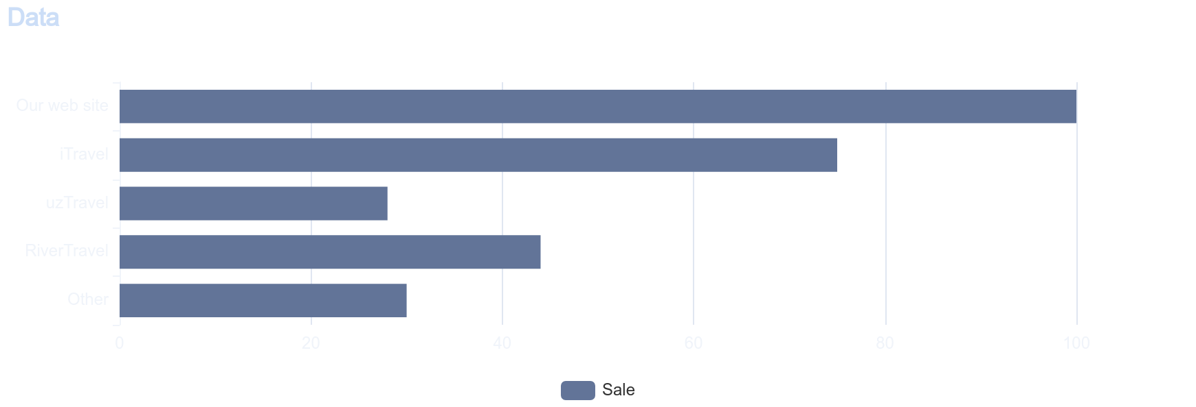
Our website's features greatly exceed those of competitors, enhancing functionality and user experience.

Slide 15

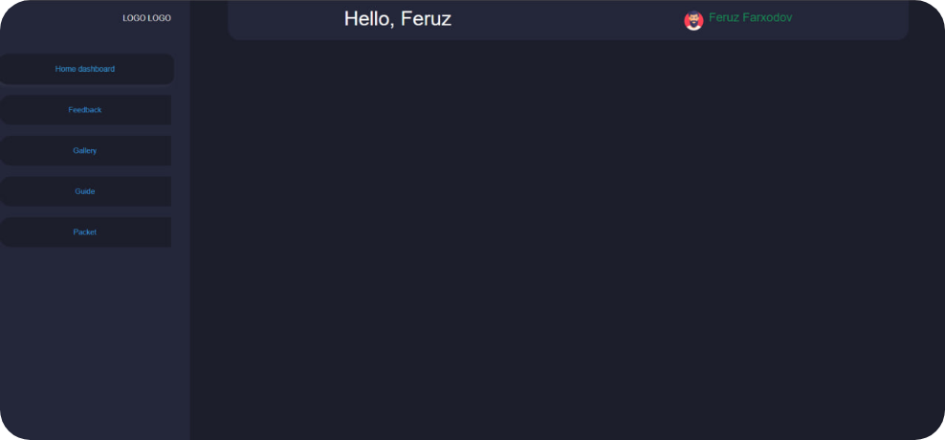
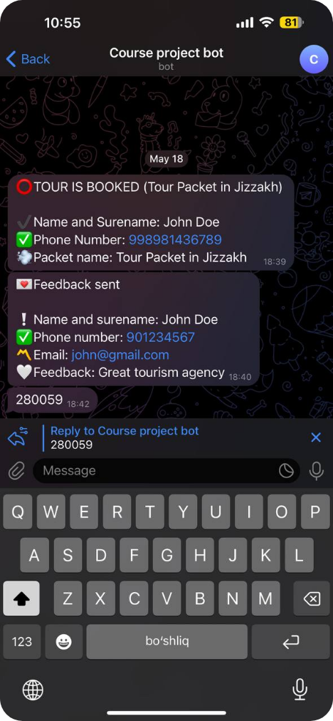
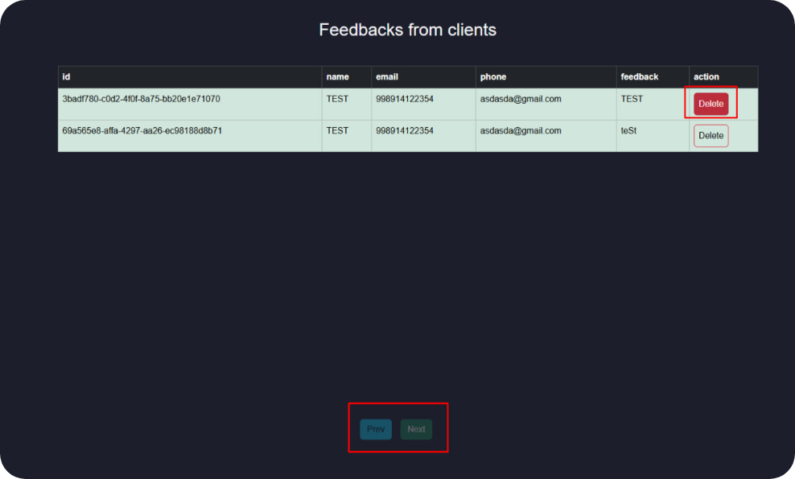
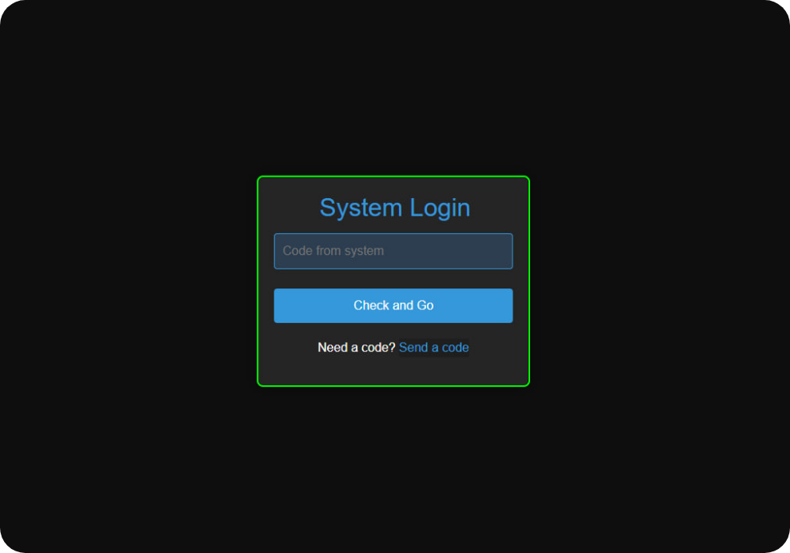
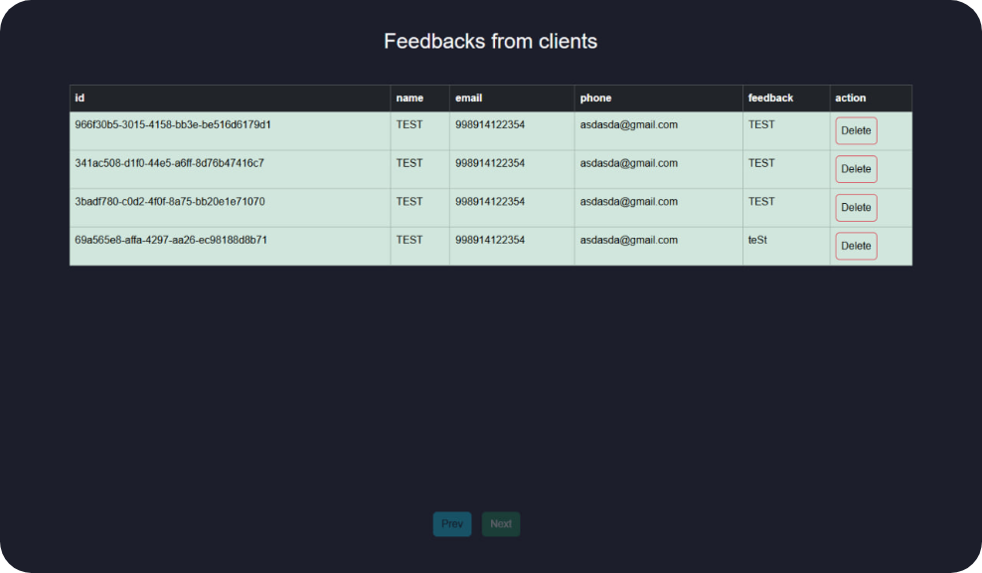
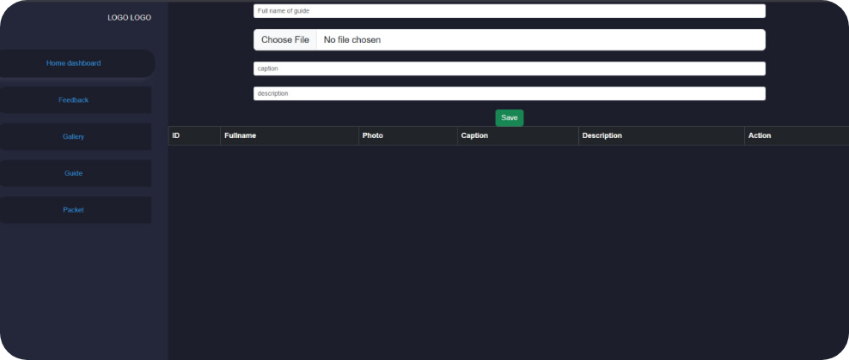
Admin Features

Slide 16

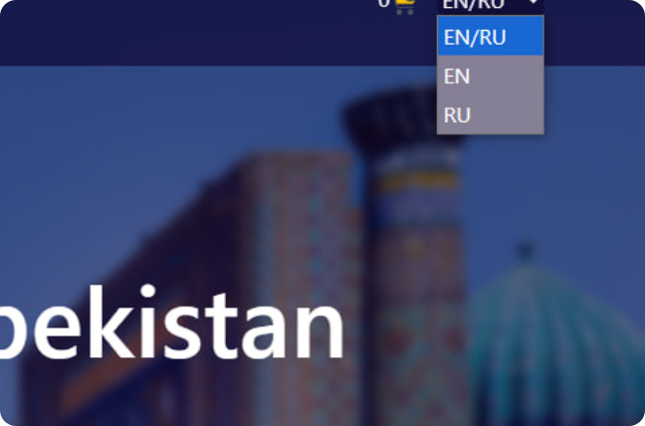
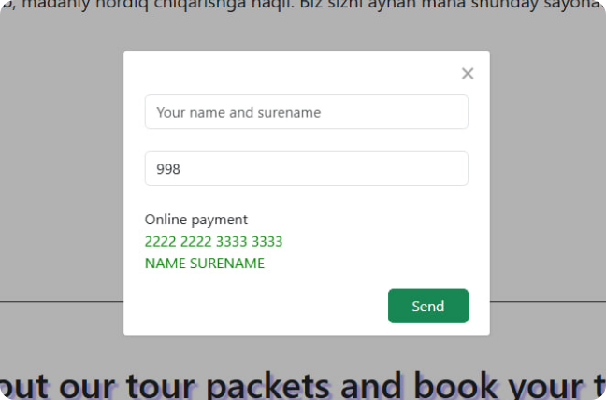
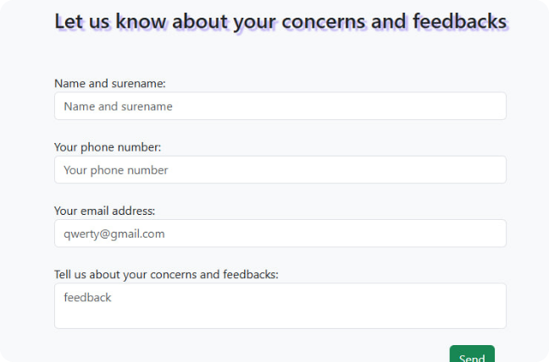
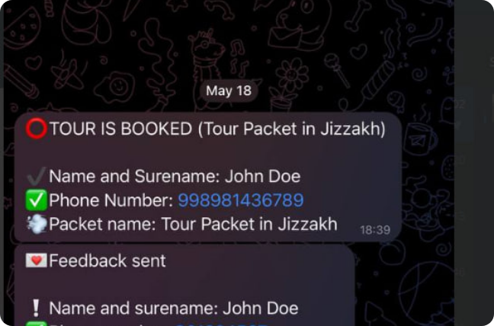
User Opportunities
Language Options
Simple Tour Booking
Personalize with various language options
Secure tour booking with no deposit
Feedback's Importance
Telegram Bot for Sharing
Feedback on concerts to admin
Get tour notifications and shared feedback

Slide 17

05
Implementation and Testing

Slide 18
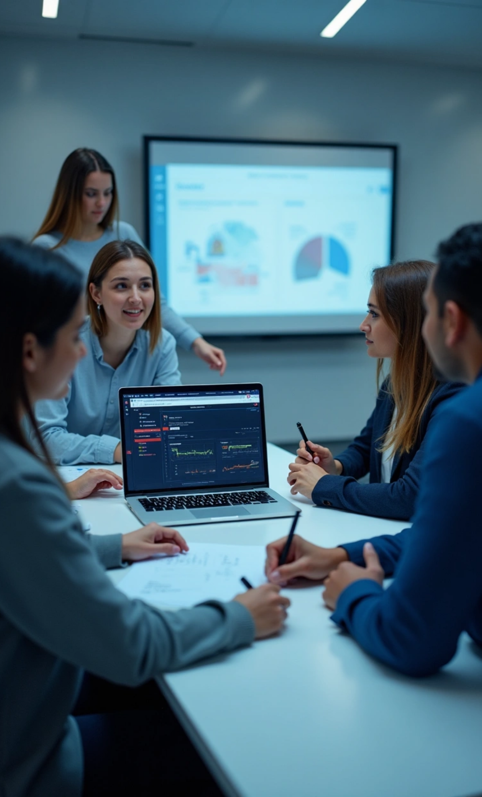
Implementation & Testing
1
Dev Steps
• Frontend with JSON-server
• Created admin panel
• Finished backend & system integration
2
Testing
• Cross-browser testing
• University students tested site & provided feedback
• Feedback improved UI & fixed bugs.

Slide 19

06
Challenges and Limitations

Slide 20



Issues Faced
Telegram Bot Setup
Responsive Design
User Feedback System
Real-time messaging and 2-step verification setup was complex.
Creating an attractive UI for all devices took time.
Developing a public feedback system required extensive backend work.
I overcame these challenges through research and testing.

Slide 21

07
Prospects and Plans

Slide 22

Future Enhancements
If I had more time, I would add:
1
Email integration
2
Statistics dashboard for the admin (e.g., bookings, users, most popular tours)
3
Auto-detection of positive/negative feedback for performance monitoring

Slide 23


Ongoing Development
I plan to keep developing this project further with:
More third-party app integrations
AI and machine learning to make business management smarter
I believe this web application can grow into a real product and even expand globally.

Slide 24
08
Thank You

